Slide 1
Saratoga data project presentation
SAm xxx
Troy Rodriguez

Slide 2
Introduction
Data name- Saratoga data(pricing)
Based on New York's 1728 single family residences
In contrast to the subjective technique used by real estate agents, regression analysis because of it gives a more objective method for valuing a property based on its attributes.
Research Question- which variable predict the sale prices in the data?

Slide 3

Methods

Slide 4
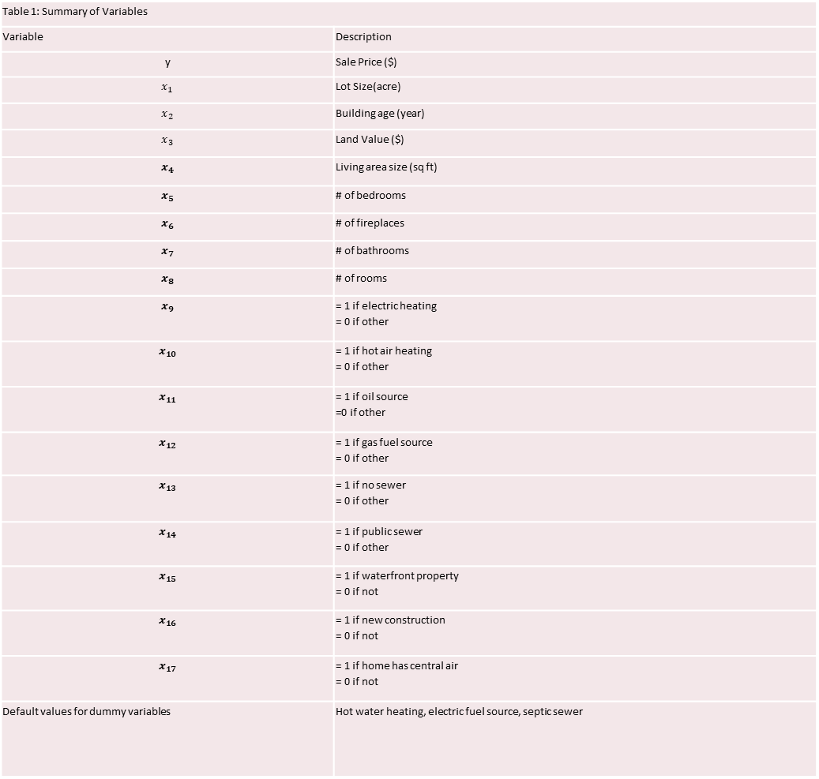
Table 1: Summary of Variables
Variable | Description
y | Sale Price ($)
$$x_{1}$$ | Lot Size(acre)
$$x_{2}$$ | Building age (year)
$$x_{3}$$ | Land Value ($)
$$x_{4}$$ | Living area size (sq ft)
$$x_{5}$$ | # of bedrooms
$$x_{6}$$ | # of fireplaces
$$x_{7}$$ | # of bathrooms
$$x_{8}$$ | # of rooms
$$x_{9}$$ | = 1 if electric heating = 0 if other
$$x_{10}$$ | = 1 if hot air heating = 0 if other
$$x_{11}$$ | = 1 if oil source =0 if other
$$x_{12}$$ | = 1 if gas fuel source = 0 if other
$$x_{13}$$ | = 1 if no sewer = 0 if other
$$x_{14}$$ | = 1 if public sewer = 0 if other
$$x_{15}$$ | = 1 if waterfront property = 0 if not
$$x_{16}$$ | = 1 if new construction = 0 if not
$$x_{17}$$ | = 1 if home has central air = 0 if not
Default values for dummy variables | Hot water heating, electric fuel source, septic sewer
Variables

Slide 5
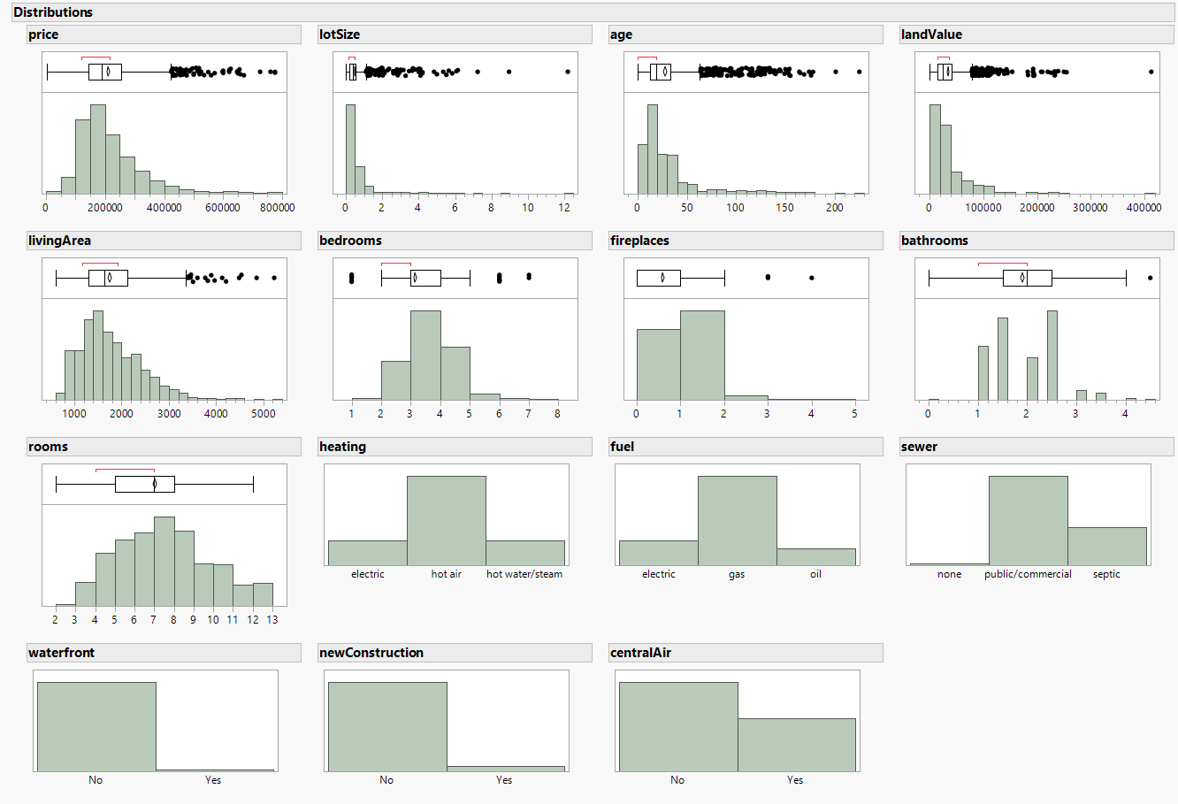

Slide 6
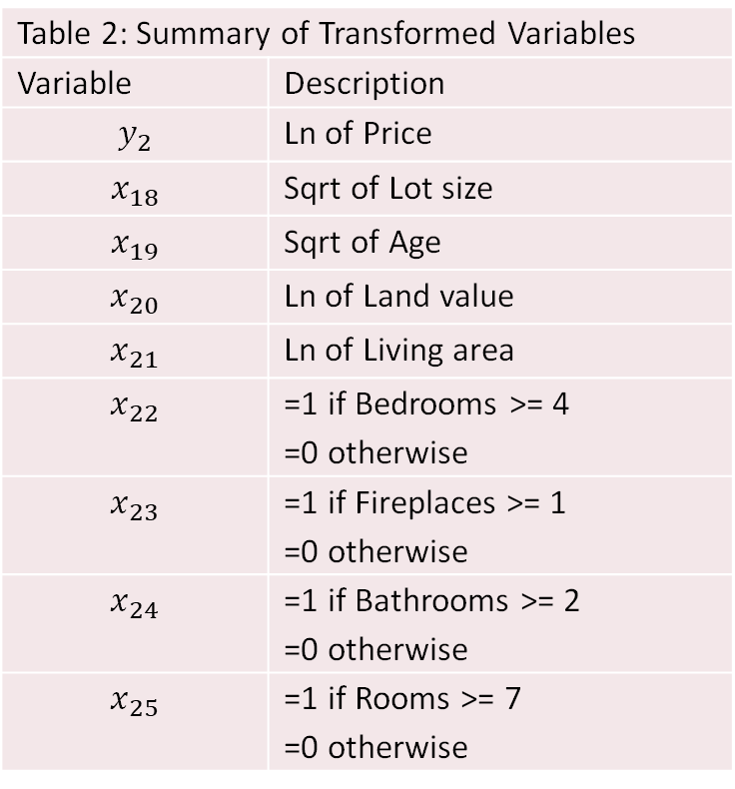
Table 2: Summary of Transformed Variables
Variable | Description
$$y_{2}$$ | Ln of Price
$$x_{18}$$ | Sqrt of Lot size
$$x_{19}$$ | Sqrt of Age
$$x_{20}$$ | Ln of Land value
$$x_{21}$$ | Ln of Living area
$$x_{22}$$ | =1 if Bedrooms >= 4 =0 otherwise
$$x_{23}$$ | =1 if Fireplaces >= 1 =0 otherwise
$$x_{24}$$ | =1 if Bathrooms >= 2 =0 otherwise
$$x_{25}$$ | =1 if Rooms >= 7 =0 otherwise
Transformed variables

Slide 7
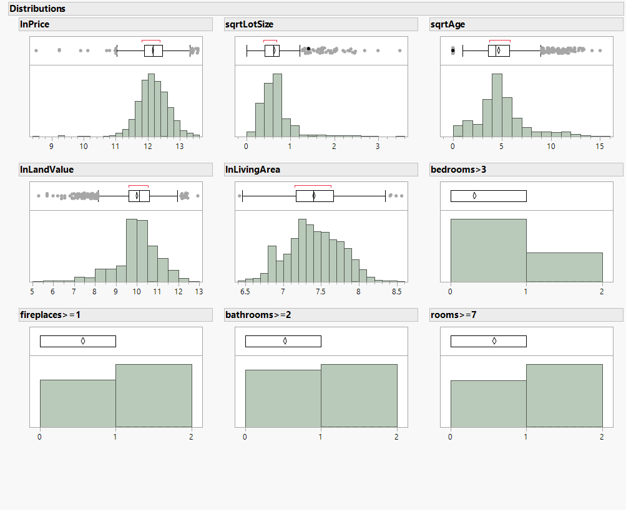

Slide 8
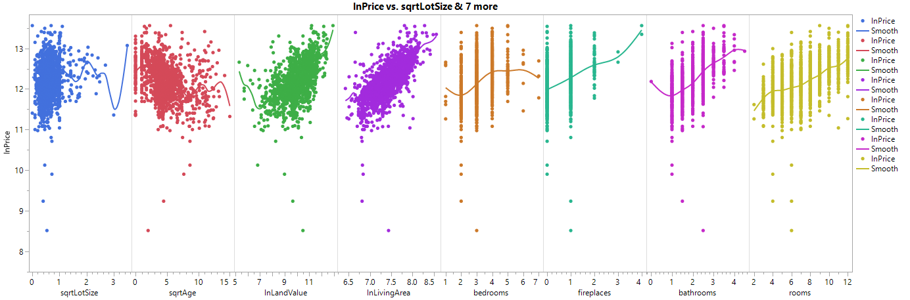
Transformed vs response

Slide 9

Models
Model 1:
$E(y) = β_{0 }+β_{1}x_{1}+β_{2}x_{2}+ ... +β_{17}x_{17}$
First order model
Violates assumptions of Least Squares Regression
Skewed variables

Slide 10

Models
Model 2
$E(y_{2}) = β_{0} +β_{1}x_{18}+β_{2}x_{19}+...+β_{8}x_{25}+β_{9}x_{9} +β_{10}x_{10}+...+β_{17}x_{17}$
First order model
Transformed variables

Slide 11
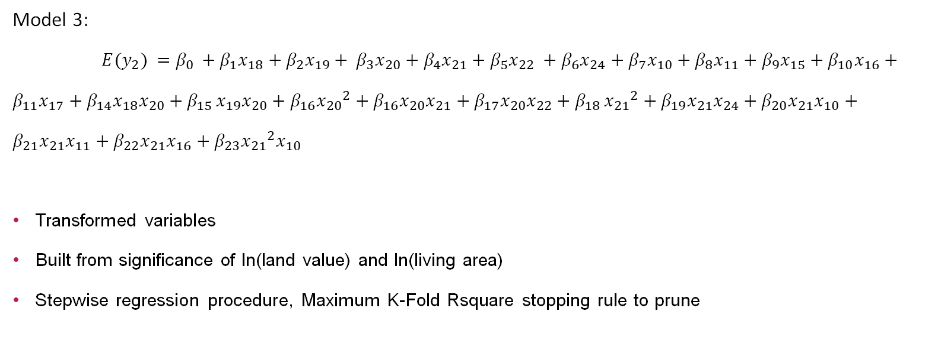
Models
Model 3:
$E(y_{2}) =β_{0 }+β_{1}x_{18}+β_{2}x_{19}+ β_{3}x_{20}+β_{4}x_{21}+β_{5}x_{22} +β_{6}x_{24}+β_{7}x_{10}+β_{8}x_{11}+β_{9}x_{15}+β_{10}x_{16}+β_{11}x_{17}+β_{14}x_{18}x_{20}+β_{15 }x_{19}x_{20}+β_{16}{x_{20}}^{2}+β_{16}x_{20}x_{21}+β_{17}x_{20}x_{22}+β_{18 }{x_{21}}^{2}+β_{19}x_{21}x_{24}+β_{20}x_{21}x_{10}+β_{21}x_{21}x_{11}+β_{22}x_{21}x_{16}+β_{23}{x_{21}}^{2}x_{10}$
Transformed variables
Built from significance of ln(land value) and ln(living area)
Stepwise regression procedure, Maximum K-Fold Rsquare stopping rule to prune

Slide 12
Testing
Partial F-test
α = 0.05
Compare:
Model Rsquare
S
Global F

Slide 13
testing
Check Least Squares Regression Assumption
Residual Analysis
Model Validation

Slide 14

RESULTS

Slide 15
Model summaries
Model | RSquare adj | Global F | S | MSE | SSE | # of Betas
1 | 0.6501 | 186.71 | 58300 | 3.3989e+9 | 5.7169e+12 | 17
2 | 0.5810 | 139.56 | 0.29 | 0.086 | 144.68631 | 17
3 | 0.6205 | 127.28 | 0.279 | 0.0779 | 130.63856 | 22

Slide 16

Partial F-test
$H_{0}: Model 3 contributes no more information than Model 2$
$H_{a}: Model 3 contributes more information than Model 2$
F = 36.07
$F_{0.05}=2.21$
Reject $H_{0}$

Slide 17
Model comparison
Choose Model 3?
Rsquare up 0.0395 (Up 6.8%)
Std. Dev. Down 0.011 (Down 3.79%)
Partial F-test results

Slide 18

Questions?

Slide 19
Influential data
Evaluate Cook’s D
None exceed 0.05
No influential data

Slide 20

Least Squares Regression(LSR) Assumption
All pairs of error terms are uncorrelated
Sales are independent
Variance of $σ^{2}$ is constant
Examine predicted vs residuals
Mean of $ε$ = 0
Computer generated
$ϵ$ is normally distributed
Examine histogram of residuals

Slide 21
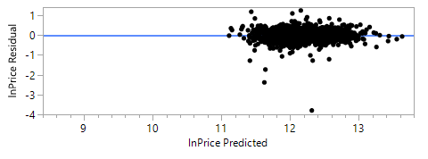
2nd lsr assumption
Appears randomly distributed
Non-influential outliers

Slide 22
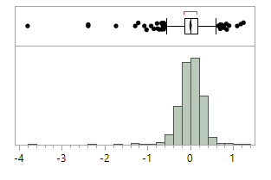
4th LSR Assumptions
Bell shape
Normally distributed
Mean = 0

Slide 23

Model validation
Stepwise procedure w/ Maximum K-fold Rsquare stopping rule
5 folds
K-fold Rsquare = 0.6138
Model Rsquare adj = 0.6205

Slide 24
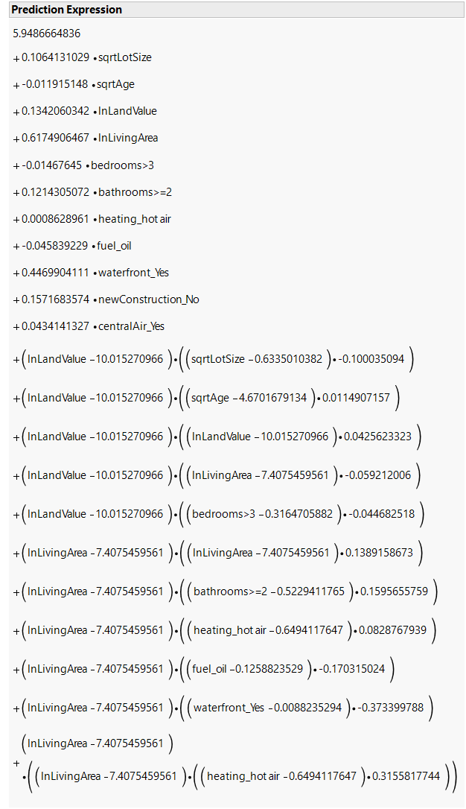
Estimates
Highest predicted price data value:
No lot size
5 years old,
$412600 land value
2472 sq ft
Bedrooms < 3
Bathrooms > 2
Hot air heating
Not oil fuel
Waterfront
Not new construction
Central air
$830680 predicted vs $775000 actual

Slide 25
Estimates
Lowest predicted price data value:
0.13-acre lot size
137 years old
$700 land value
814 sq ft
Bedrooms < 3
Bathrooms < 2
Hot air heating
Gas fuel
Not waterfront
Not new construction
No central air
$66836 predicted vs $65000 actual

Slide 26
Conclusion
Model 3 is high predictor of price.
we found that these 23 parameters are high predictor for sale prices,
Sqrt of Lot size(x18), Sqrt of Age (𝑥19), Ln of Land value(20), Ln of Living area (𝑥21), (𝑥22)1 if Bedrooms >= 4, 0 =otherwise, (𝑥24) =1 if Bathrooms >= 2, 0 =otherwise and 7 other additional attributes of the house variable.
Then interaction variable are Sqrt of Lot Size and Ln of Land value (x18x20), lot size interact with land value,
Similarly, Sqrt of Age and Ln of Land value(x19x20) and 9 other interaction term.

Slide 27
Continue
And This variable increased the sale price : land value, waterfront properties and living area.
And fueled by oil, the price will decrease,

Slide 28
What to do different next time?
Choose the more parsimonious model.
Fully ignore invalid models

Slide 29
Questions?

